Slide 1
Mini Project On Early Detection and Intervention for the Aging Population
-Health is Wealth
Internal Guide:
Mr.K.Raghupathi
(Associate Professor)
CSE(DS)
Presented by
J.Srija -22AG1A6724
K.Nagender Reddy-22AG1A6729
MD.Sameer -22AG1A6741
D.Pranith Kumar-23AG5A6703

Slide 2
TABLE OF CONTENTS
Title
Abstract
Introduction⁠
Literature survey
⁠Existing System Drawbacks
⁠Proposed System &Advantages
⁠Functional Requirements
Non-functional Requirements
Software Requirements
Hardware Requirements
System Architecture
UML Diagrams

Slide 3
ABSTRACT
With the rise in aging populations, real-time health monitoring is crucial for timely medical help.ByteLife is a health monitoring system designed to track vital signs and alert caregivers to health issues.It monitors real-time health data such as heart rate, blood pressure, oxygen levels (SpO2), body temperature. Provides early warnings for chronic diseases by analyzing deviations from normal health trends.Automatically notifies caregivers when abnormalities are detected, ensuring a fast medical response.Suggests remedies and precautions to help manage and improve elderly health.

Slide 4
INTRODUCTION
As people age increases, they become more vulnerable to health issues, making it crucial to monitor their health continuously.
To monitor vital signs and activity levels, and provide necessary interventions to improve overall health.
Goal: Enhance care through scalable, secure, and efficient health monitoring

Slide 5
Literature Survey

Slide 6
.
2020

Slide 7
Existing System & It’s Drawbacks
No real-time health monitoring for elderly individuals.
Delay in emergency response due to lack of alerts.
No use of Machine Learning (ML) for condition prediction.
No automatic remedy or medicine suggestions.
Caregivers lack remote access to health conditions.
Increased health risks due to delayed medical attention.

Slide 8
Proposed System
The Proposed Model is designed to overcome the drawbacks of the existing system by utilizing Machine Learning (ML) to predict health conditions, provide real-time monitoring, and send automated alerts to caregivers.
Real-Time Health Monitoring:
The system will continuously monitor vital signs such as:
Heart Rate
Blood Pressure
Oxygen Level (SpO2)
Body Temperature
Health Condition Prediction:
Machine Learning algorithms will analyze health data to predict conditions as:
Normal – No health issues detected.
Abnormal – Potential health issue detected.
Critical – Immediate medical attention required.

Slide 9
3.Automated Alert System: The system will automatically send email alerts to caregivers if the condition is: Abnormal – Early intervention required. Critical – Immediate medical attention required. 4.Medicine and Remedy Suggestions: Based on the predicted condition, the system will suggest: Remedies (e.g., rest, hydration, medication, etc.). Medicines (based on standard medical practices).

Slide 10
Proposed System Advantages
Real-time Monitoring – Continuously tracks vital health parameters.
Smart Predictions – ML-based analysis offers accurate condition prediction.
Automated Alerts – Sends timely alerts to caregivers for quick action.
Dynamic Remedy Suggestions – Remedies are personalized based on condition.
Caregiver Integration – Connects elderly with caregivers via alert system.
Improved Safety – Enables faster response during critical health situations.

Slide 11
Functional Requirements
Machine Learning Analysis: The backend should process the input data using machine learning algorithms to detect any abnormal health patterns.
Abnormality Detection: If any health parameter is outside the safe range, the system should flag it as an abnormality.
Email Alert to Caretaker: When an abnormal condition is detected, the system must immediately send an email alert to the registered caretaker.
Remedy and Medicine Suggestion: Based on the condition, the system should suggest relevant remedies and over-the-counter medicines using a rule-based AI approach.

Slide 12
Non-Functional Requirements
Real-time Processing: Analysis and alerts should be done instantly after data submission, with minimal delay.
High Availability: The system must be consistently accessible and operational whenever needed, especially during emergencies.
User-Friendly Interface: The web interface should be simple, clean, and accessible for elderly users with large buttons and readable fonts.
Reliable Email Alert System: Emails should be sent without failure, ensuring caretakers are informed on time.

Slide 13
Software Requirements:
Operating System: Windows
Python 3.x – For coding and Machine Learning.
Flask Framework – To create the web interface.
scikit-learn, Pandas, NumPy – For Machine Learning models.
HTML, CSS, JavaScript – For web page design.
Hardware Requirements:
Hard Disk: SSD Storage.
RAM: Minimum 4GB .
Internet Connection: Required for sending email alerts.

Slide 14
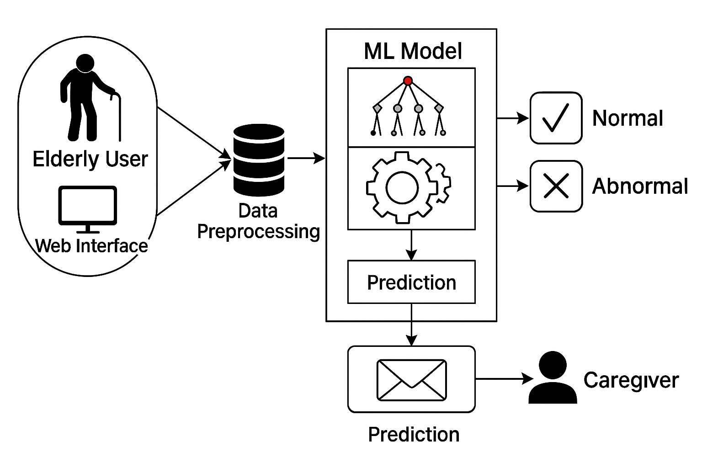
⁠System Architecture

Slide 15
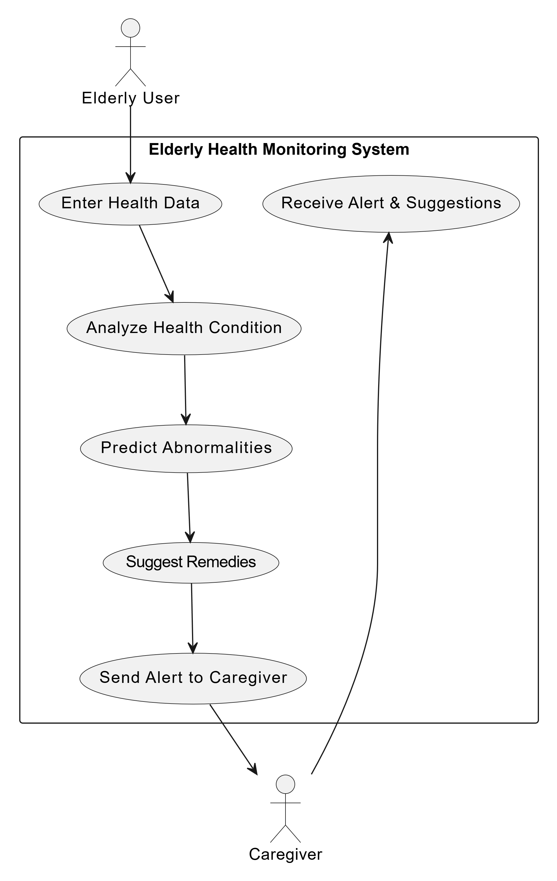
Use Case Diagram

Slide 16
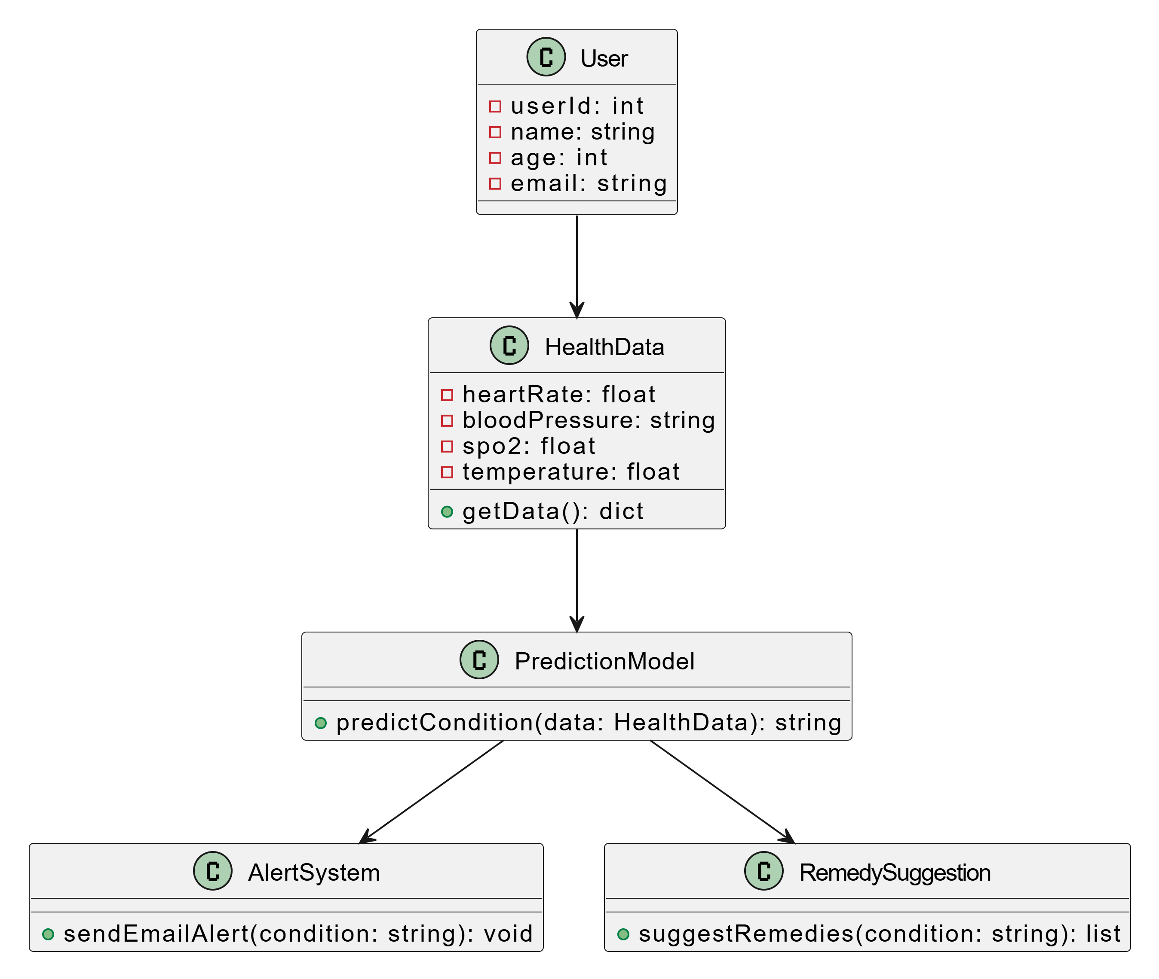
Class Diagram

Slide 17
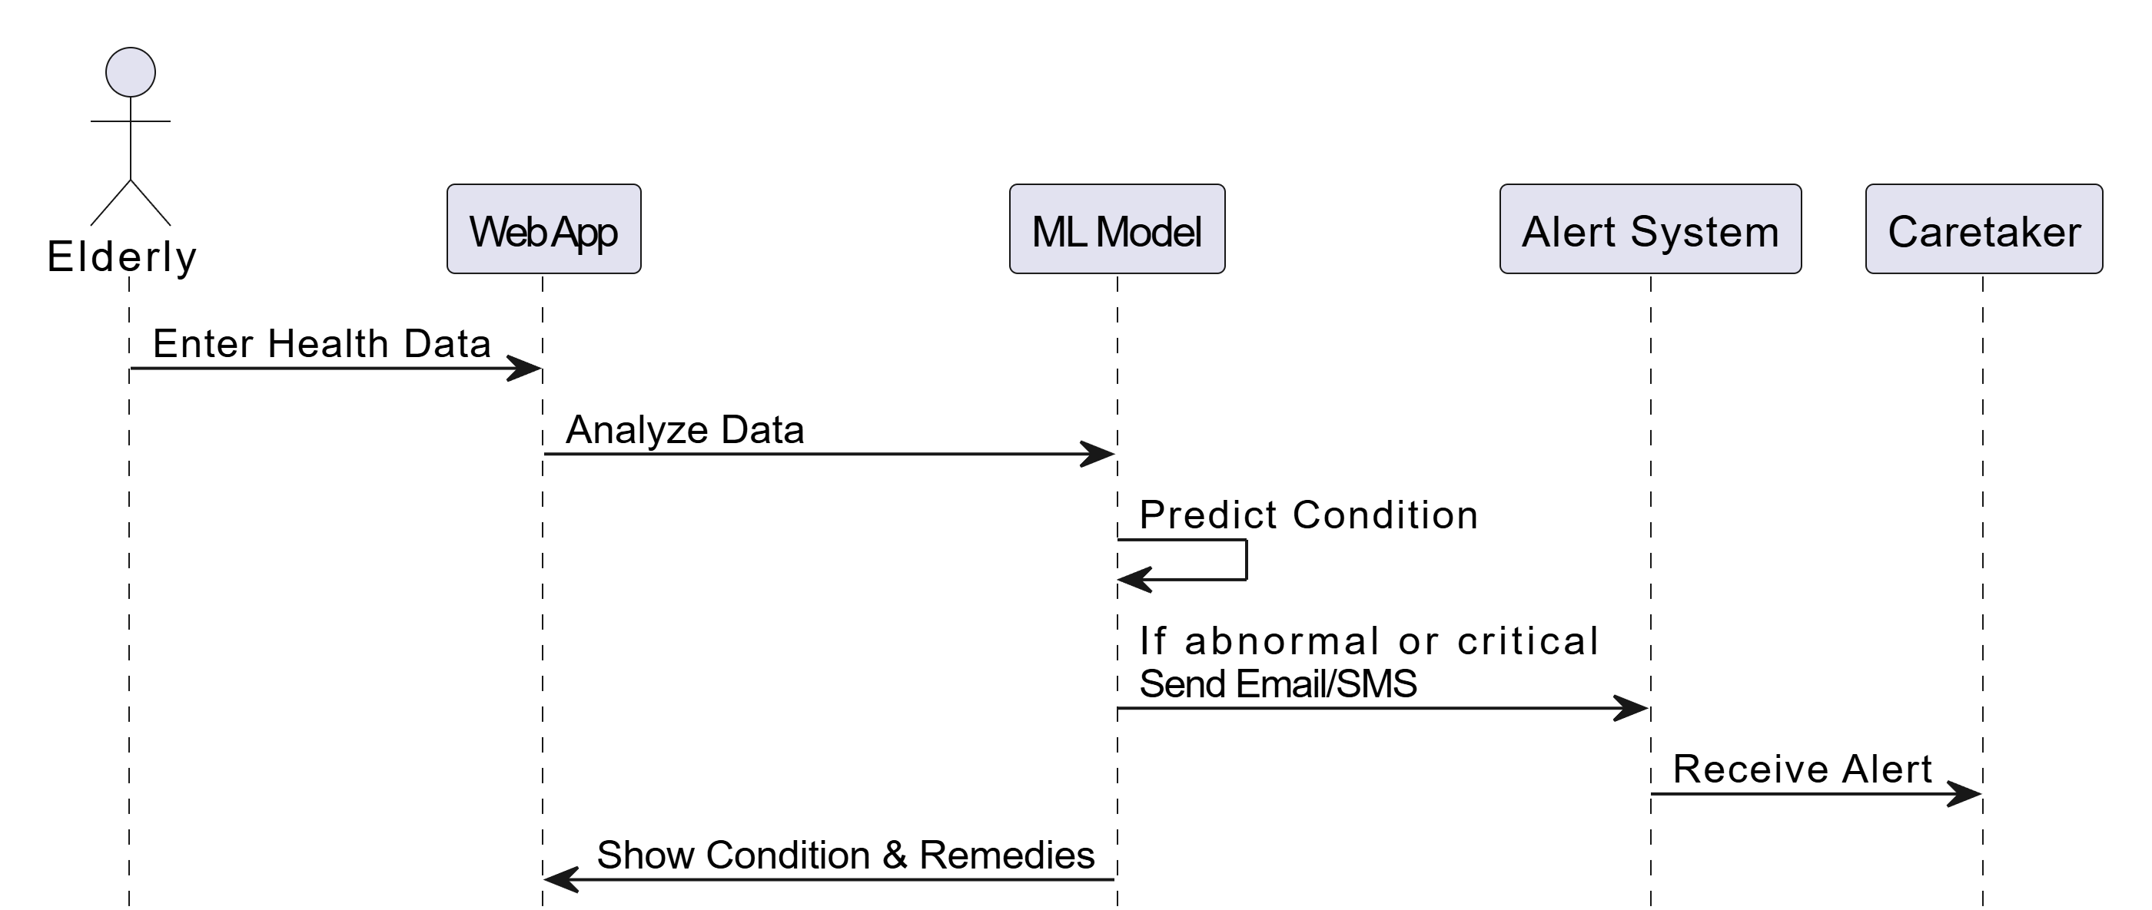
Sequence Diagram

Slide 18
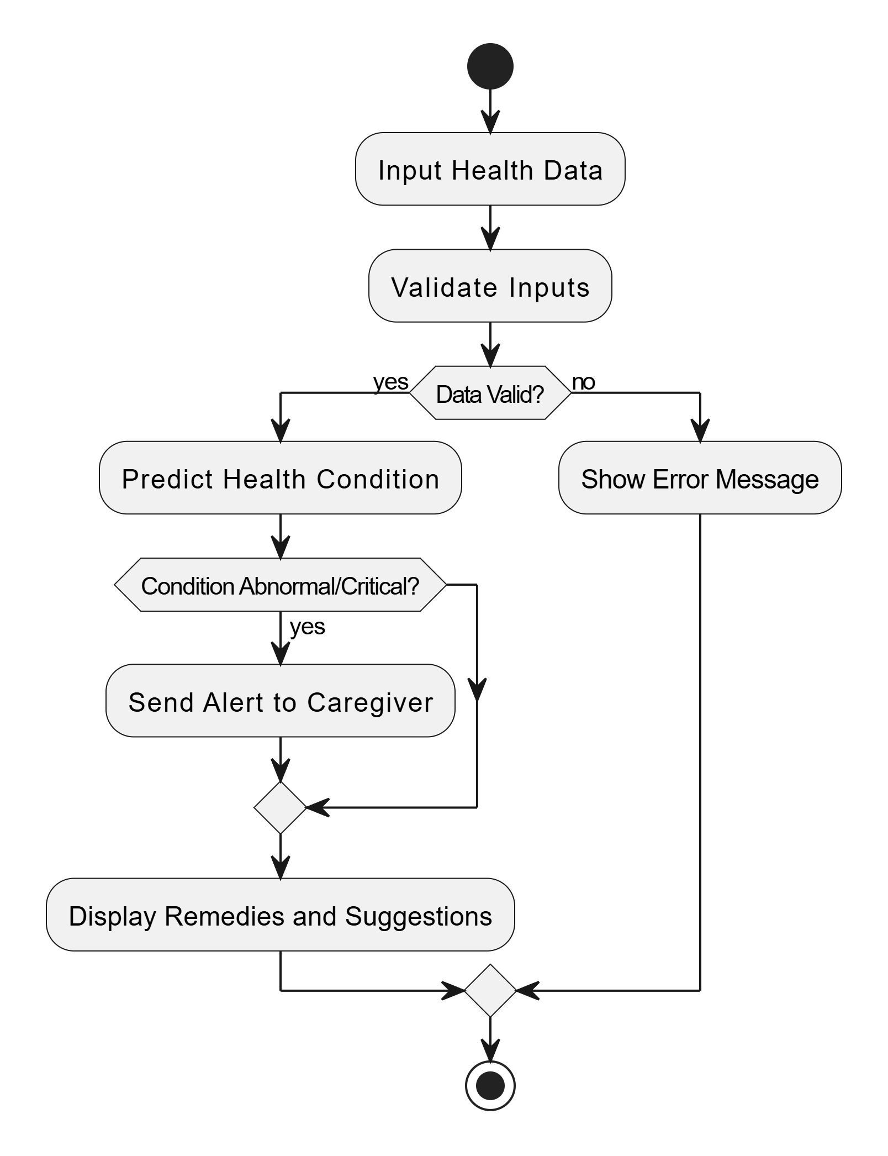
Activity Diagram

Slide 19
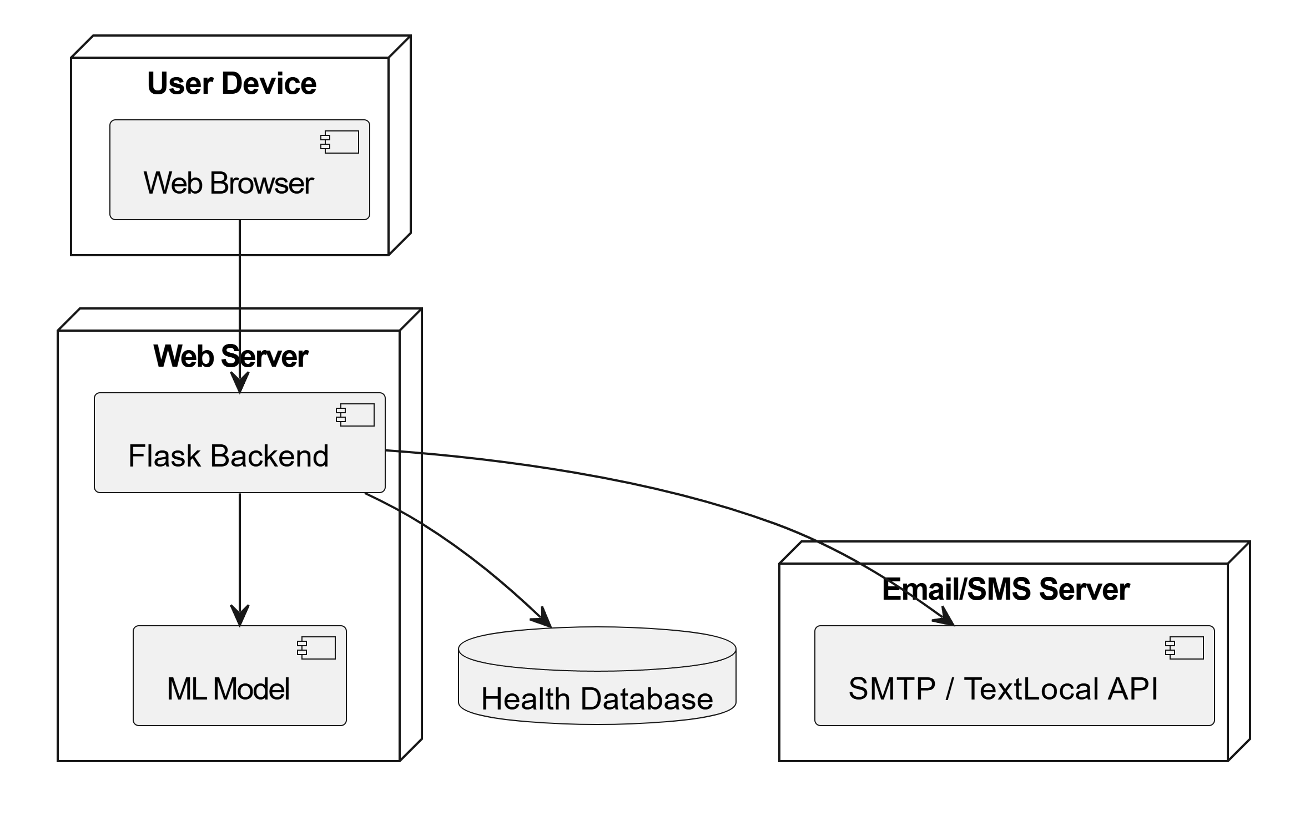
Deployment Diagram

Slide 20
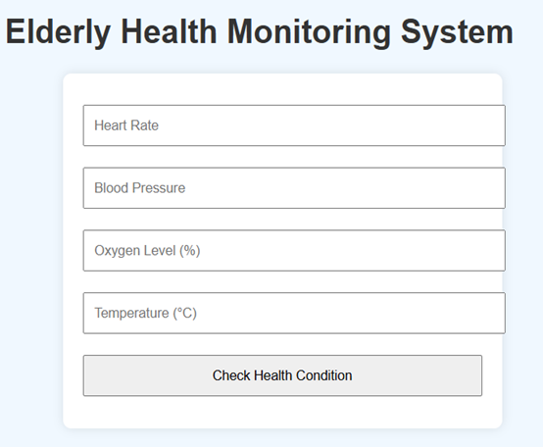
OUTPUT SCREENS:
This allows users to enter health details like:
Heart Rate
Blood Pressure
Oxygen Level (%)
Temperature (°C) Then, they click "Check Health Condition" to see the result.
USER INTERFACE

Slide 21
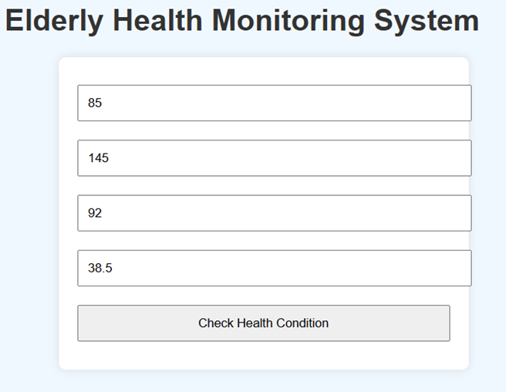
Enter Input Values Example values are entered: Heart Rate: 85 Blood Pressure: 145 Oxygen Level: 92% Temperature: 38.5°C These values are checked to find out the person’s health status.
ENTER INPUT VALUES

Slide 22
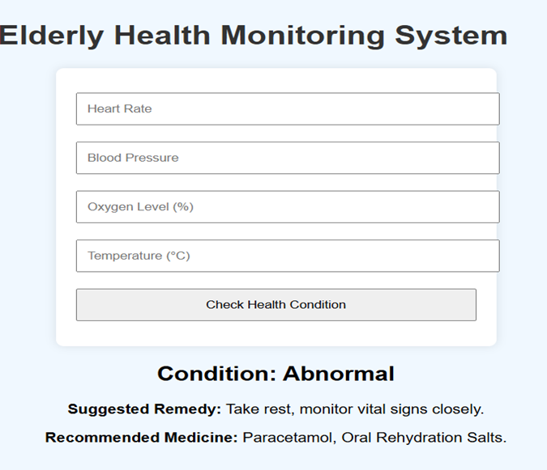
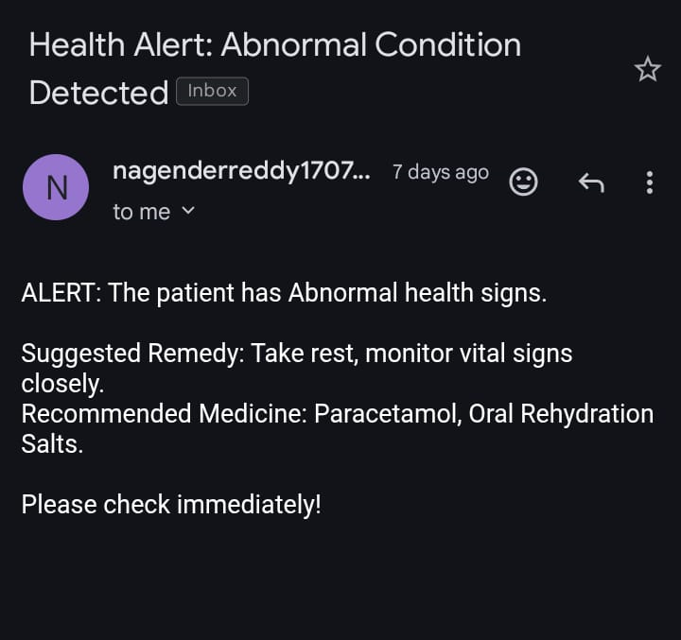
The system detects Abnormal. It suggests: 1.Remedy 2.Recommended Medicine 3.Alert to Caregiver
RESULTS FOR GIVEN INPUTS

Slide 23
Conclusion:
This project introduces ByteLife, a system that helps monitor the health of elderly people in real time. It checks important signs like heart rate, blood pressure, oxygen level, and body temperature. Using Machine Learning, it can tell if the person’s condition is normal, abnormal, or critical. If there’s a problem, it sends an alert to caregivers through email. It also gives helpful tips, precautions, and medicine suggestions. This system helps in early detection, faster care, and better health management for the elderly.

Slide 24
Future Scope:
1.Integration with IoT Devices
Expand the system to connect with real-time IoT-enabled wearable devices for continuous, wireless health monitoring.
2.Mobile App Development
Develop a cross-platform mobile application to provide users and caregivers with instant health updates and notifications.
3.Advanced Predictive Models
Incorporate deep learning algorithms (e.g., LSTM, CNN) for more accurate prediction of complex health patterns over time.
4.Voice-Activated Assistance
Enable voice interaction (using NLP) for elderly users who may struggle with traditional interfaces.
5.Emergency Services Integration
Automatically notify nearby hospitals or emergency services in case of critical health conditions.

Slide 25
THANKS!

